Slide 1
IAS 19 EMPLOYEE BENEFITS
Short-term employee benefits
Post-employment benefits
Termination benefits
Other long-term employee benefits

Slide 2
IAS 19 EMPLOYEE BENEFITS
Definitions (.08) –all forms of consideration given by an entity in exchange for service rendered by employees or for the termination of employment.
Objective of IAS 19:
Prescribe the accounting and disclosure of employee benefits.
IAS 19 requires an entity to recognise:
an expense when the entity consumes the economic benefit arising from service provided by an employee in exchange for employee benefits.
a liability when an employee has provided service in exchange for employee benefits to be paid in the future
MONEY
CAR
LEAVE
BONUS
PENSION
MEDICAL
HOUSING ALLOWANCE
GOODS
Dt Employee benefits (P/L)
Cr Liability / Provision / Bank (SFP)

Slide 3
IAS 19 EMPLOYEE BENEFITS Scope (.02-.07)
Applies to:
Employers that must account for employee benefits.
Benefits includes those provided by:
formal plans/agreements
legislative requirements/industry arrangements
informal practices /constructive obligation
Categories:
short-term employee benefits
post-employment benefits
long-term employee benefits
termination benefits

Slide 4
IAS 19 EMPLOYEE BENEFITS Short-term benefits
Definition (.08)
Employee benefits (other than termination benefits) that are expected to be settled wholly before twelve months after the end of the period in which the employees render the related service
Examples (.09)

Slide 5
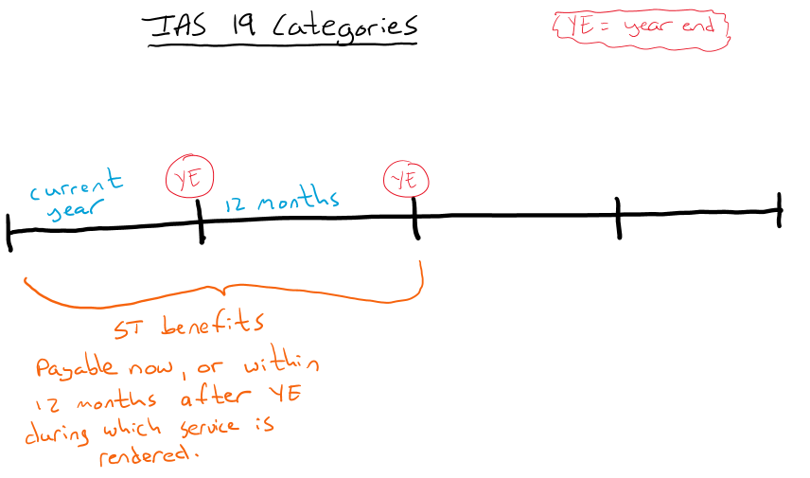
IAS 19 EMPLOYEE BENEFITS Short-term benefits

Slide 6
IAS 19 EMPLOYEE BENEFITS Short-term benefits
Recognition and measurement (.11)
Undiscounted amount
All short-term employee benefits (.11)
Within 12 months of YE
Entry
Dr Expense (p/l)
Cr Liability (Accrued expense) (SFP)
NB Remember to deduct amount already paid from the liability
NB If amount paid > undiscounted amount of benefit?
* Prepaid expense

Slide 7
IAS 19 EMPLOYEE BENEFITS Short-term benefits
Profit-sharing and bonus plans (.19 - .24)
Recognise expected cost only when:
Obligation (legal or constructive) &
Reliable estimate of obligation
A present obligation only exists when the entity has no realistic alternative but to make the payments.
If not paid within 12 months after end of period in which employees rendered the related service → LT employee benefits

Slide 8
IAS 19 EMPLOYEE BENEFITS Short-term benefits
Disclosure (.25)
Nothing specific
Refer to other standards
Related parties (IAS 24)
Employee benefits expense (IAS 1)
Companies Act
Directors' remuneration

Slide 9
IAS 19 EMPLOYEE BENEFITS Short-term benefits
Short-term paid absences (.13 -.18)
13(a) Accumulating
Recognise: when the employees render service that increases their entitlement to future compensated absences
Measure: the additional amount that the entity expects to pay as a result of the unused entitlement that has accumulated at the end of the reporting period.
vesting: entitled to a cash payment for unused entitlement on leaving the entity
non-vesting: not entitled….
13(b) Non-accumulating
Recognise : when the absences occur

Slide 10
IAS 19 EMPLOYEE BENEFITS Post-employment benefits
Definition (.08)
Employee benefits (other than termination benefits and Short-term benefits) which are payable after the completion of employment
Defined contribution plans
Defined benefit plans (excluded from SAICA syllabus)

Slide 11
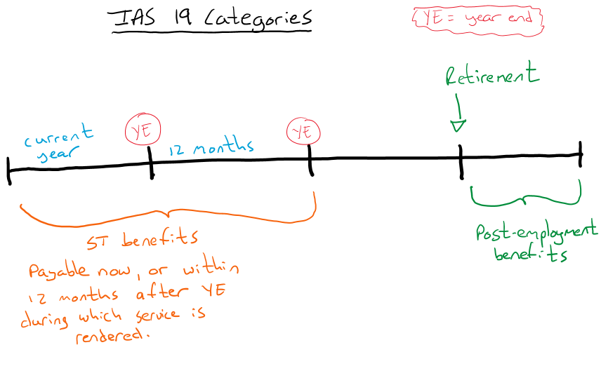
IAS 19 EMPLOYEE BENEFITS Post-employment benefits

Slide 12
IAS 19 EMPLOYEE BENEFITS Post-employment benefits
Defined contribution plans
Recognition & measurement (.51 - .52)
Entry
When an employee has rendered service to an entity during a period:
Dr Expense (P/L)
Cr Liability / Bank (SFP)
Where contributions do not fall due wholly within twelve months after the end of the period in which the employees render the related service, they shall be discounted using the discount rate
Disclosure (.53 - .54)
the amount recognised as an expense

Slide 13
IAS 19 EMPLOYEE BENEFITS Termination benefits (.159 - .164)
Definition (.08)
Employee benefits payable as a result of either:
an entity’s decision to terminate an employee’s employment before the normal retirement date; or
an employee’s decision to accept voluntary redundancy in exchange for those benefits.

Slide 14
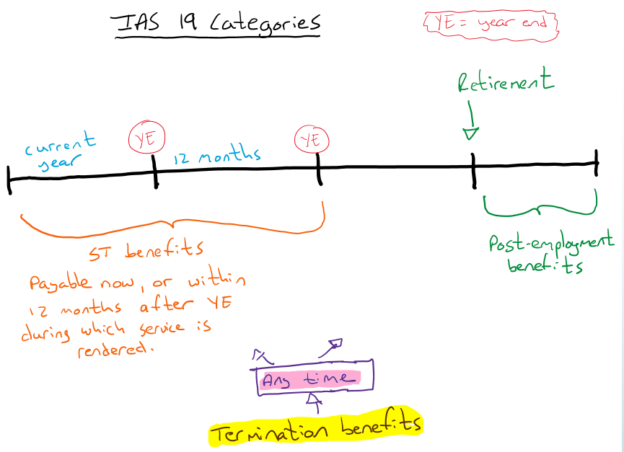
IAS 19 EMPLOYEE BENEFITS Termination benefits (.159 - .164)

Slide 15
IAS 19 EMPLOYEE BENEFITS Termination benefits (.159 - .164)
Recognition (.165 - .168)
Expense and liability – earliest of:
Can no longer withdraw offer
Recognise cost for restructuring ito IAS 37 that involves payment of termination benefits
Measurement (.169 - .170)
Settled before 12 months – apply rules of short-term benefits
Settled after 12 months – apply rules of other long-term benefits
Disclosure (.171)
No specific requirements
Refer IAS 1, IAS 24 and IAS 37

Slide 16
IAS 19 EMPLOYEE BENEFITS Other long-term benefits (.153 - .158)
Definition (.08)
Employee benefits other than ST, post-employment benefits and termination benefits.
(That are not due to be settled within twelve months after the end of the period in which the employees render the related service)
(excluded from SAICA syllabus)

Slide 17
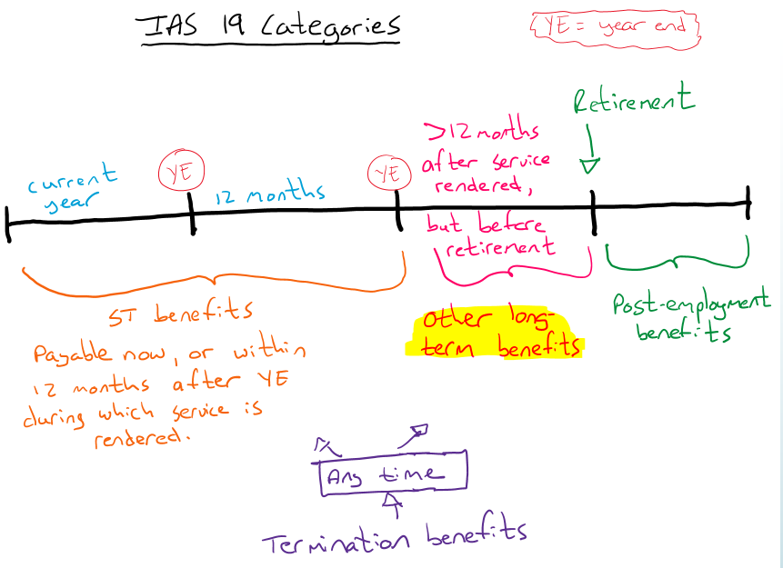
IAS 19 EMPLOYEE BENEFITS Other long-term benefits (.153 - .158)

Slide 18
IAS 19 EMPLOYEE BENEFITS Multiple employer plans
Par 32 – 45: Excluded from SAICA syllabus

